Slide 1
Secure Data Hiding in Image Using Steganography
CAPSTONE PROJECT
Presented By: Dhasari Anusha
Student Name : Dhasari Anusha
College Name & Department : Institute of aeronautical Engineering, CSE-Cyber Security

Slide 2
OUTLINE
Problem Statement
Technology used
Wow factor
End users
Result
Conclusion
Git-hub Link
Future scope

Slide 3
Problem Statement
With the exponential growth of digital communication, ensuring secure data transmission has become a critical concern. Traditional encryption methods are often detectable, raising the risk of interception. This study addresses the need for concealing sensitive information within images using steganography techniques, providing a robust and imperceptible layer of security to protect data from unauthorized access while maintaining image quality.

Slide 4
Technology used
Hardware :
Processor : AMD Ryzen 3
Operating System : Windows 11
Technology :
Language : Python 3.13.2
Libraries : cv2
Platform :
Python IDLE

Slide 5
Wow factors
Real-Time Encryption:
Hides the message directly in the image using pixel RGB values, enabling immediate results.
Password Protection:
Ensures secure decryption, restricting access to authorized users only.
Simple Yet Effective:
Demonstrates a basic but practical approach to steganography using Python and OpenCV.
User-Friendly Design:
Automatically opens the encrypted image for instant viewing.

Slide 6
End users
Individuals : People seeking secure communication for personal or sensitive data sharing.
Organizations : Businesses needing to protect confidential information in images.
Students and Educators : Those learning or teaching cryptography, steganography, or Python programming.
Digital Forensics Experts : Professionals embedding hidden data for watermarking or evidence tagging.
Developers and Researchers : Innovators exploring secure communication or enhancing existing steganography tools.

Slide 7
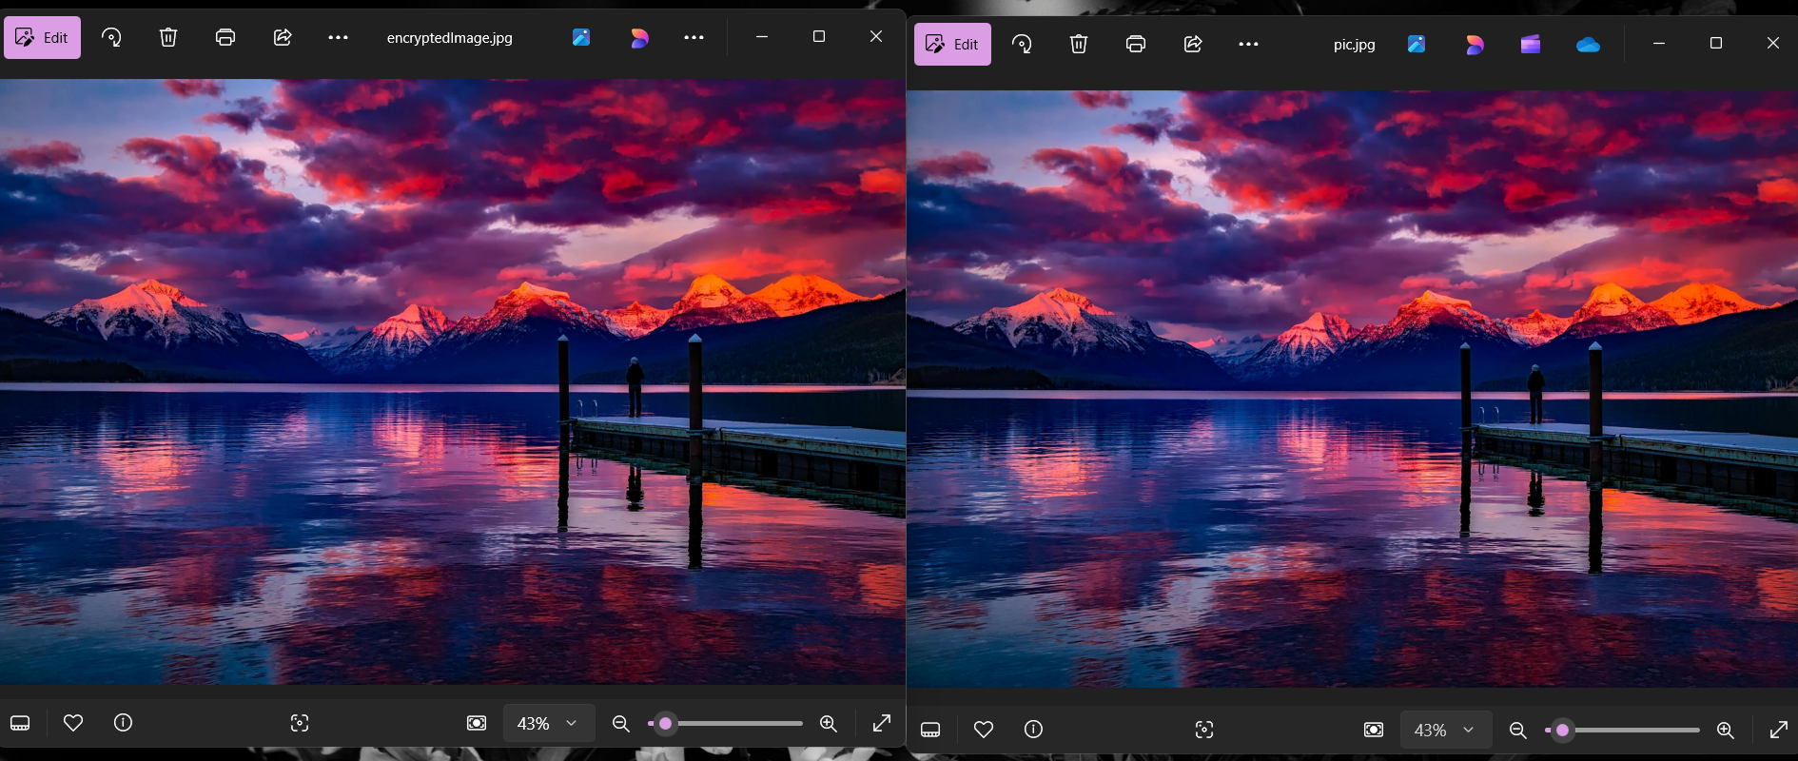
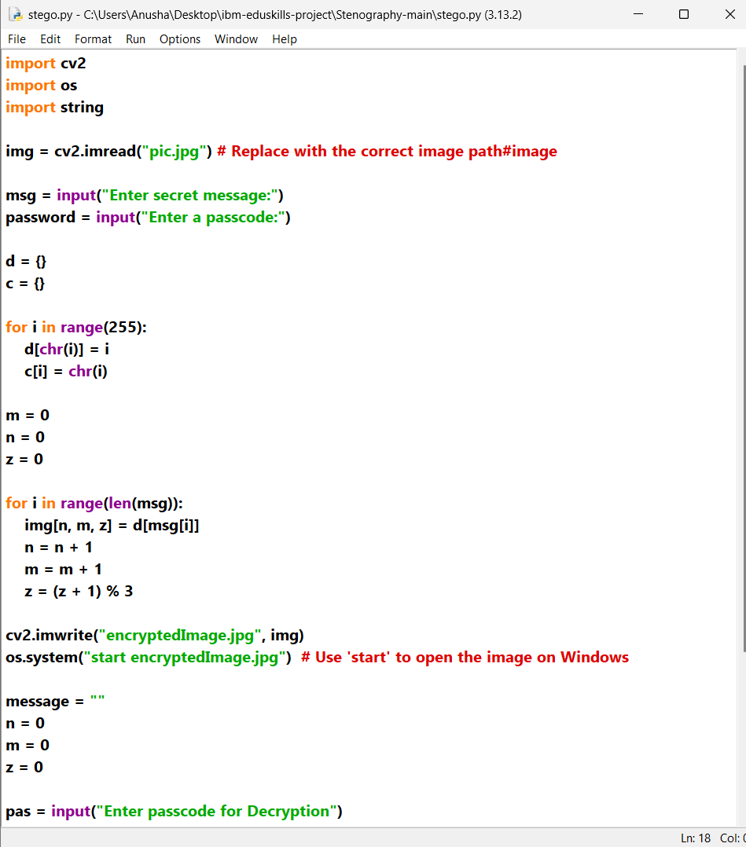

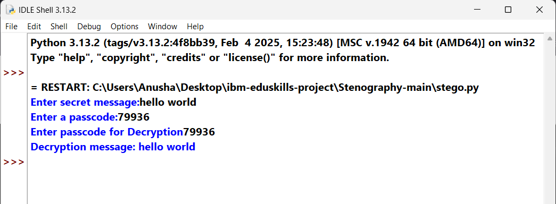
Results

Slide 8
Conclusion
This project successfully addresses the problem of secure data transmission by embedding sensitive information within images using Python-based steganography. By leveraging pixel manipulation and password protection, it ensures the data remains imperceptible and accessible only to authorized users. The implementation highlights simplicity, practicality, and adaptability, making it suitable for real-world applications and a robust solution to the challenges of secure communication in the digital age.

Slide 9
GitHub Link
https://github.com/Anusha-3113/Stegnography-project.git

Slide 10
Future scope(optional)
Smarter Techniques : Adding advanced methods to hide data more effectively, making it almost impossible to detect.
Stronger Security : Encrypting the hidden message for extra protection, so even if found, it stays safe.
Handling More Data : Allowing users to hide bigger messages or even files like audio or video within images.
Easier to Use : Building a simple app or interface so anyone can use it, not just tech-savvy people.
More Durable : Making the hidden message resistant to compression or image edits, ensuring it stays intact.

Slide 11
THANK YOU

